Slide 1
Translation App Concept UI
Group 20
Version 1.1 (Release)

Slide 2

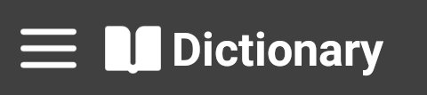
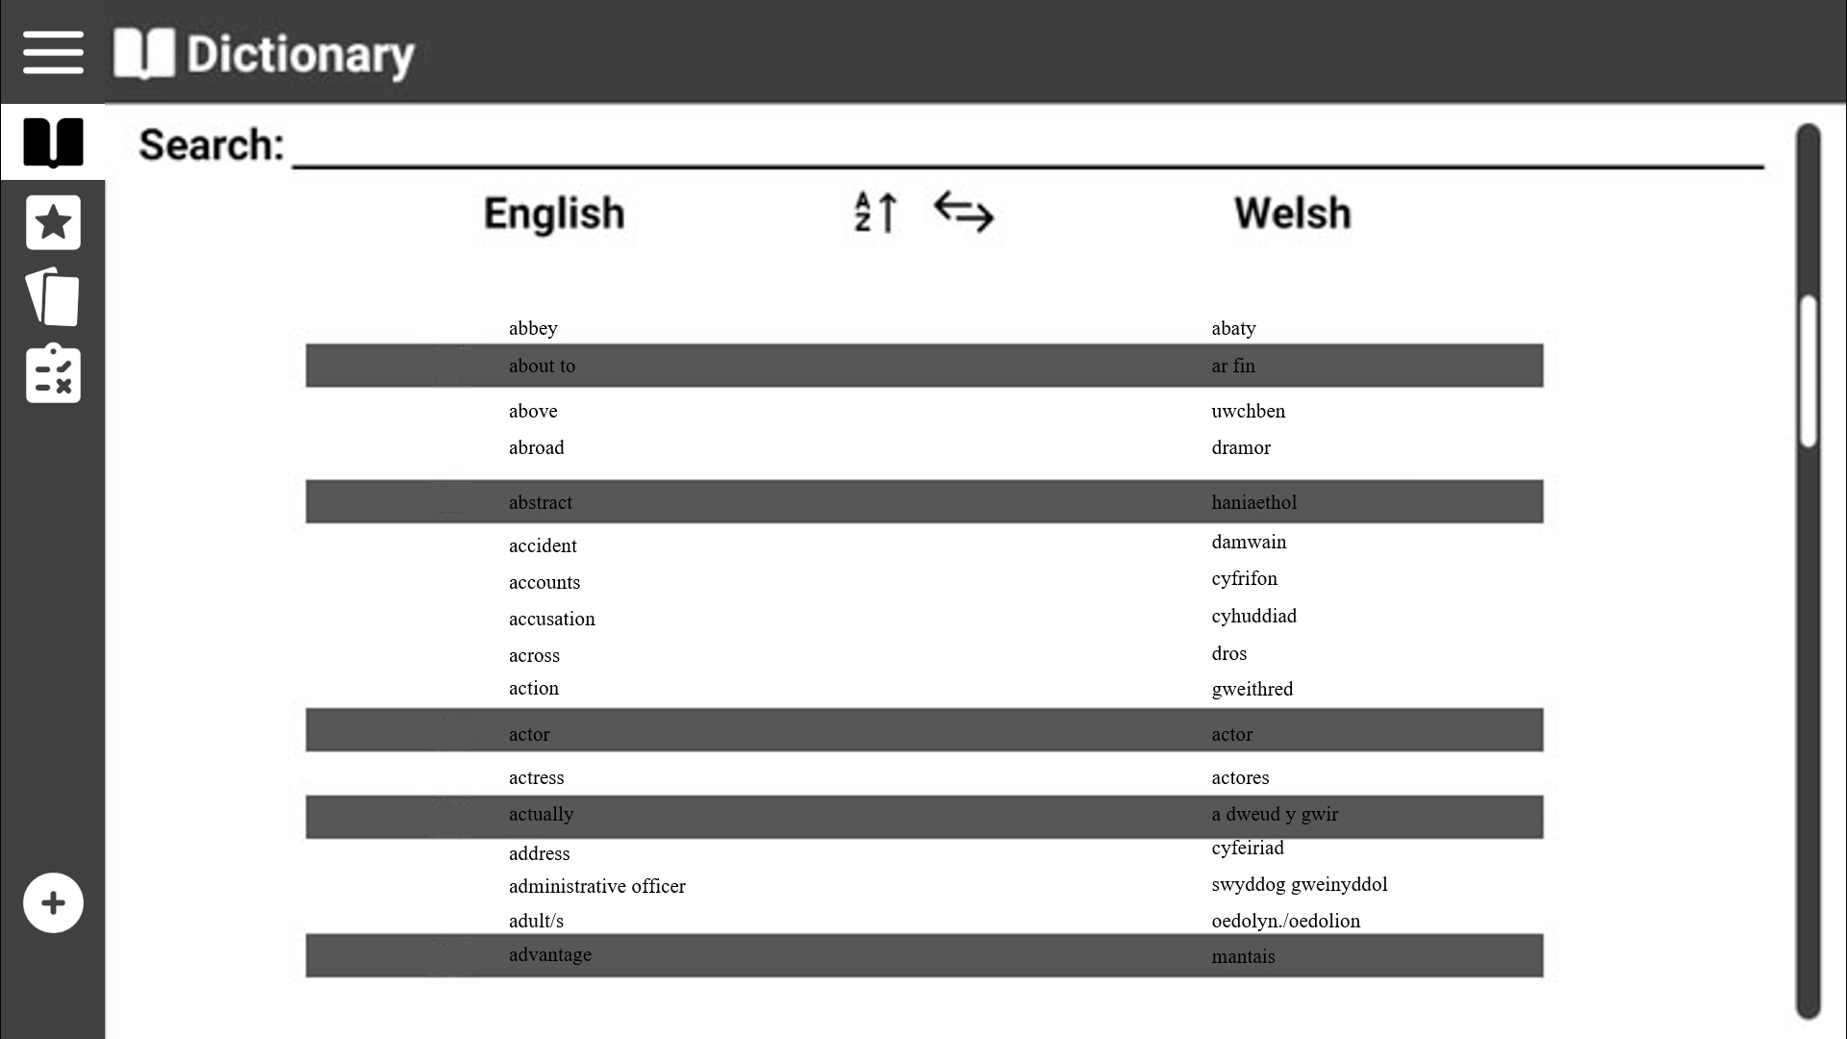
Page title
This shows the general layout of the program
Expand menu
Scroll bar
Menu options

Slide 3

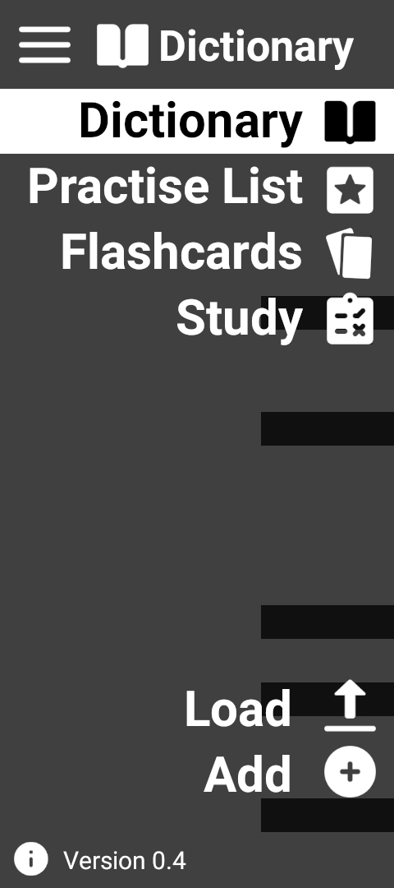
This shows the menu expanded
Current page highlighted
Click here to expand the menu
Click on menu items to switch to their page

Slide 4
This shows the general layout of the program
You can also switch pages by directly clicking on the icon when the menu isn’t expanded

Slide 5
Use Case 1: View dictionary
Click on the ‘Dictionary’ Icon

Slide 6
Use Case 1: View dictionary
Switch language sorting
User is then presented with the ‘Dictionary’ page
Change ascending/decending
Noting gender for Welsh nouns

Slide 7
Use Case 2: Search for a word
Click on ‘Dictionary’ or ‘Practice List’

Slide 8
Use Case 2: Search for a word
Click on the search textbox and start to type for your word

Slide 9
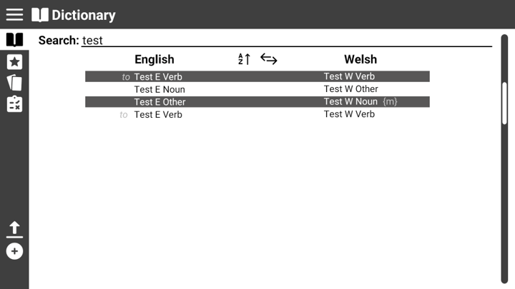
Use Case 2: Search for a word
Results from the search are filtered and displayed in real time (live searching)

Slide 10
Use Case 3: View practice list
Click on the ‘Practice List’ icon

Slide 11
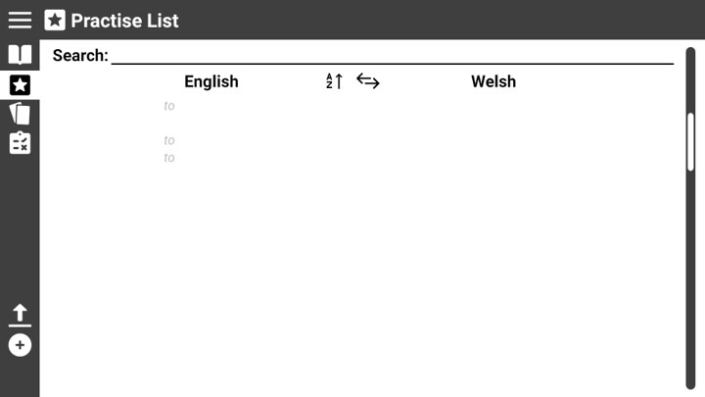
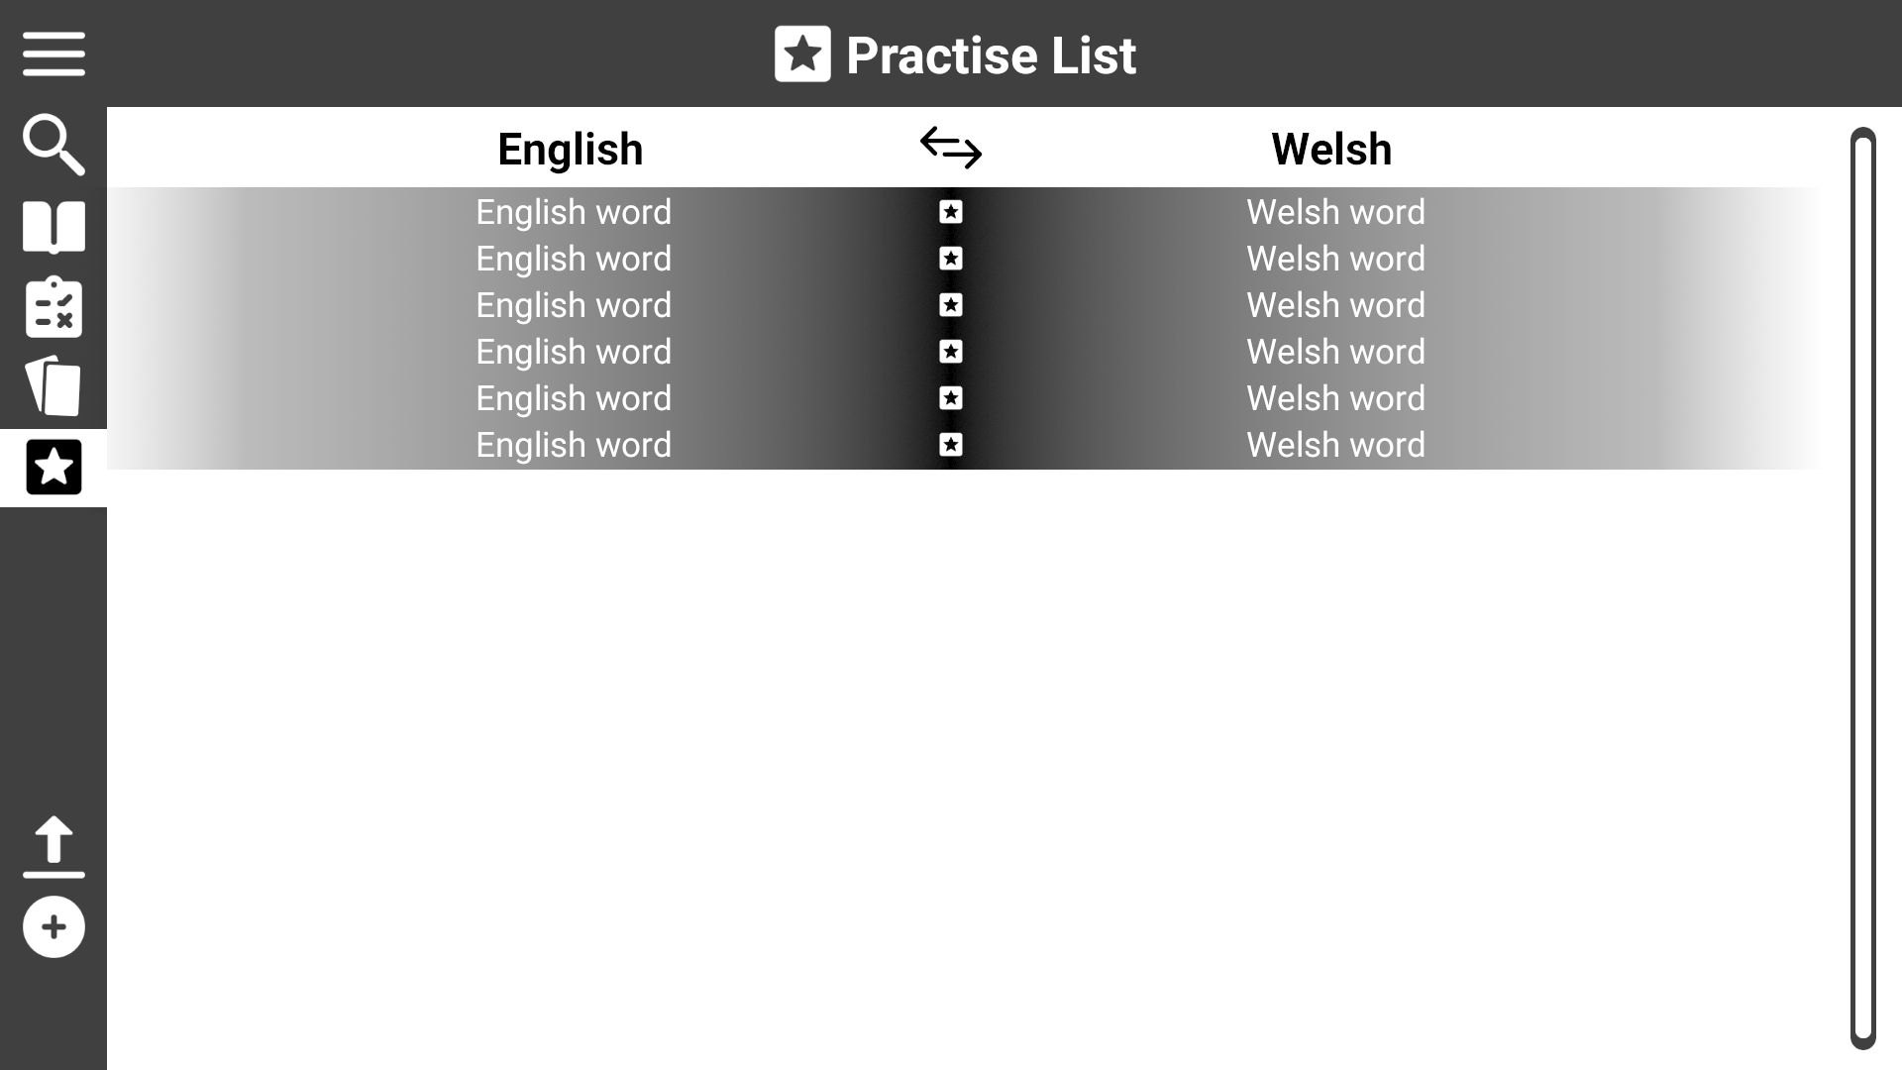

Use Case 3: View practice list
abbey
abaty
abroad
dramor
accounts
cyfrifon
adult/s
oedolyn./oedolion
User is presented with the ‘Practice List’ page

Slide 12
Use Case 4: Modify practice list
abbey
abaty
abroad
dramor
accounts
cyfrifon
adult/s
oedolyn./oedolion
Click on the ‘Practice List’ page

Slide 13
Use Case 4: Modify practice list
abbey
abaty
abroad
dramor
accounts
cyfrifon
adult/s
oedolyn./oedolion
Click on a word to remove it from the practice list
You can only remove practise words from the ‘Practice List’ page.

Slide 14
Use Case 4: Modify practice list
abbey
abaty
abroad
dramor
accounts
cyfrifon
adult/s
oedolyn./oedolion
Click on the ‘Dictionary’ icon
To add words to the list need to visit the ‘Dictionary’ page

Slide 15
Use Case 5: Start a test
Click on the ‘Study’ icon

Slide 16
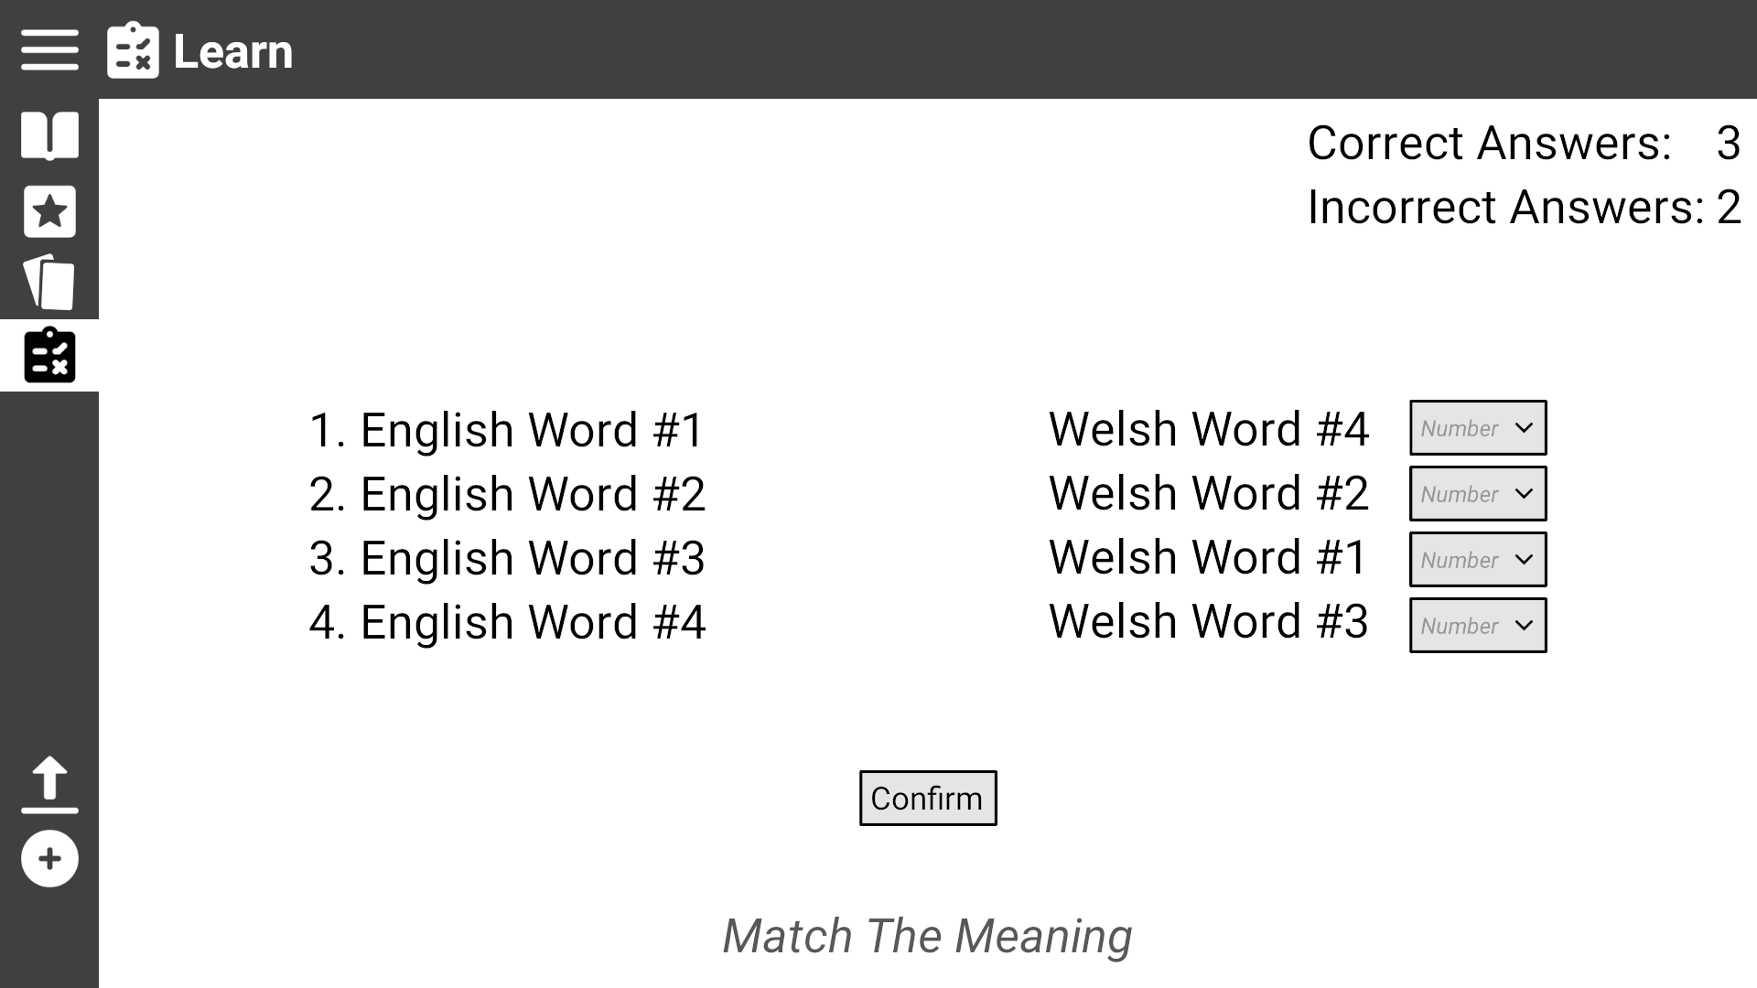

Use Case 5: Start a test
The user is randomly placed within one of three test types. In this instance we will show ‘Match The Meanings’ as the randomly selected test.
Afal
Raining
Oren
Orange
Cath
Apple
Byrw Glaw
Cat

Slide 17
Use Case 5.1: Start ‘Match The Meaning’ test
The user is presented with eight words (four pairs) and must match the word to it’s meaning by dragging it next to the word horizontally
The user is presented with a record of their current score
Afal
Raining
Oren
Orange
Cath
Apple
Byrw Glaw
Cat
Name of type of test

Slide 18
Use Case 5.2: Start ‘6 Meanings’ test
Click the ‘Study’ icon
Afal
Raining
Oren
Orange
Cath
Apple
Byrw Glaw
Cat

Slide 19
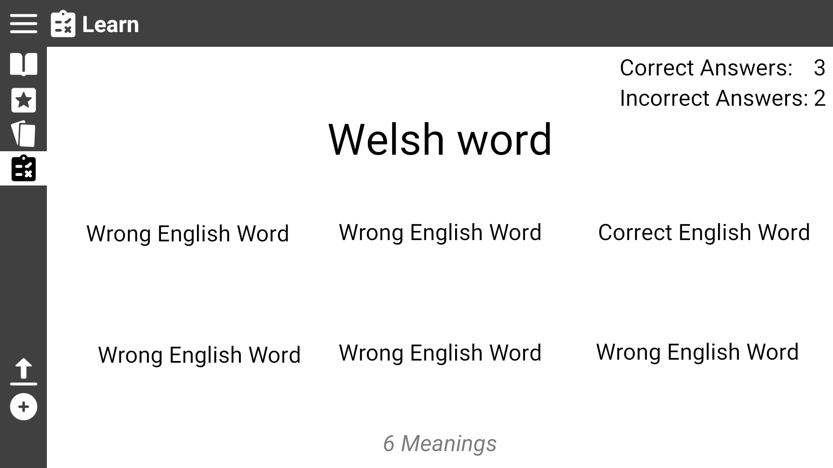
Use Case 5.2: Start ‘6 Meanings’ test
Click on the ‘Study’ icon
Afal
After
Dog
Apple
Horse
Love
Raining
The user is randomly placed within another test type at random excluding the last test type that was played. In this instance we will show ‘six meanings’ as the randomly selected test.

Slide 20
The user is presented with a word in Welsh/English with six words in the other language.
The user must click on the one they believe matches the meaning of the large word
Use Case 5.2: Start ‘6 Meanings’ test
Afal
The user is presented with a record of their current score
After
Dog
Apple
Horse
Love
Raining
Name of type of test

Slide 21
Use Case 5.3: Start ‘Translation’ test
Click the ‘Study’ icon
Afal
After
Dog
Apple
Horse
Love
Raining

Slide 22
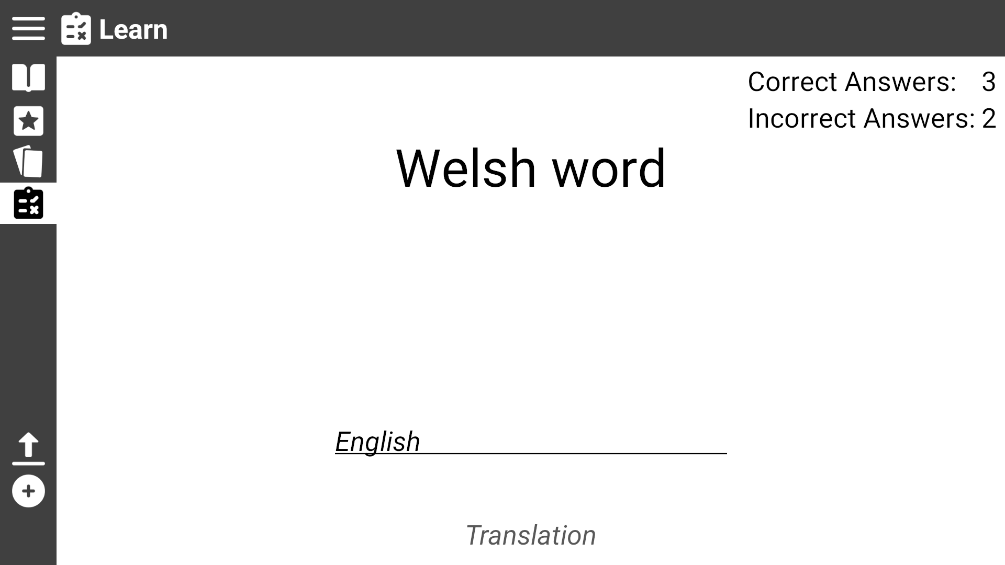
Use Case 5.3: Start ‘Translation’ test
Afal
The user is randomly placed within another test type at random excluding the last test type that was played. In this instance we will show six meanings as the randomly selected test.
The user is randomly placed within another test type at random excluding the last test type that was played. In this instance we will show ‘Translation’ as the randomly selected test.

Slide 23
The user is presented with a word in Welsh/English a textbox. The user must type the translation of the word in the textbox
Use Case 5.3: Start ‘Translation’ test
Afal
The user is presented with a record of their current score
Name of type of test

Slide 24
Use Case 6: View Flashcards
Click the ‘Flashcards’ icon
Afal

Slide 25

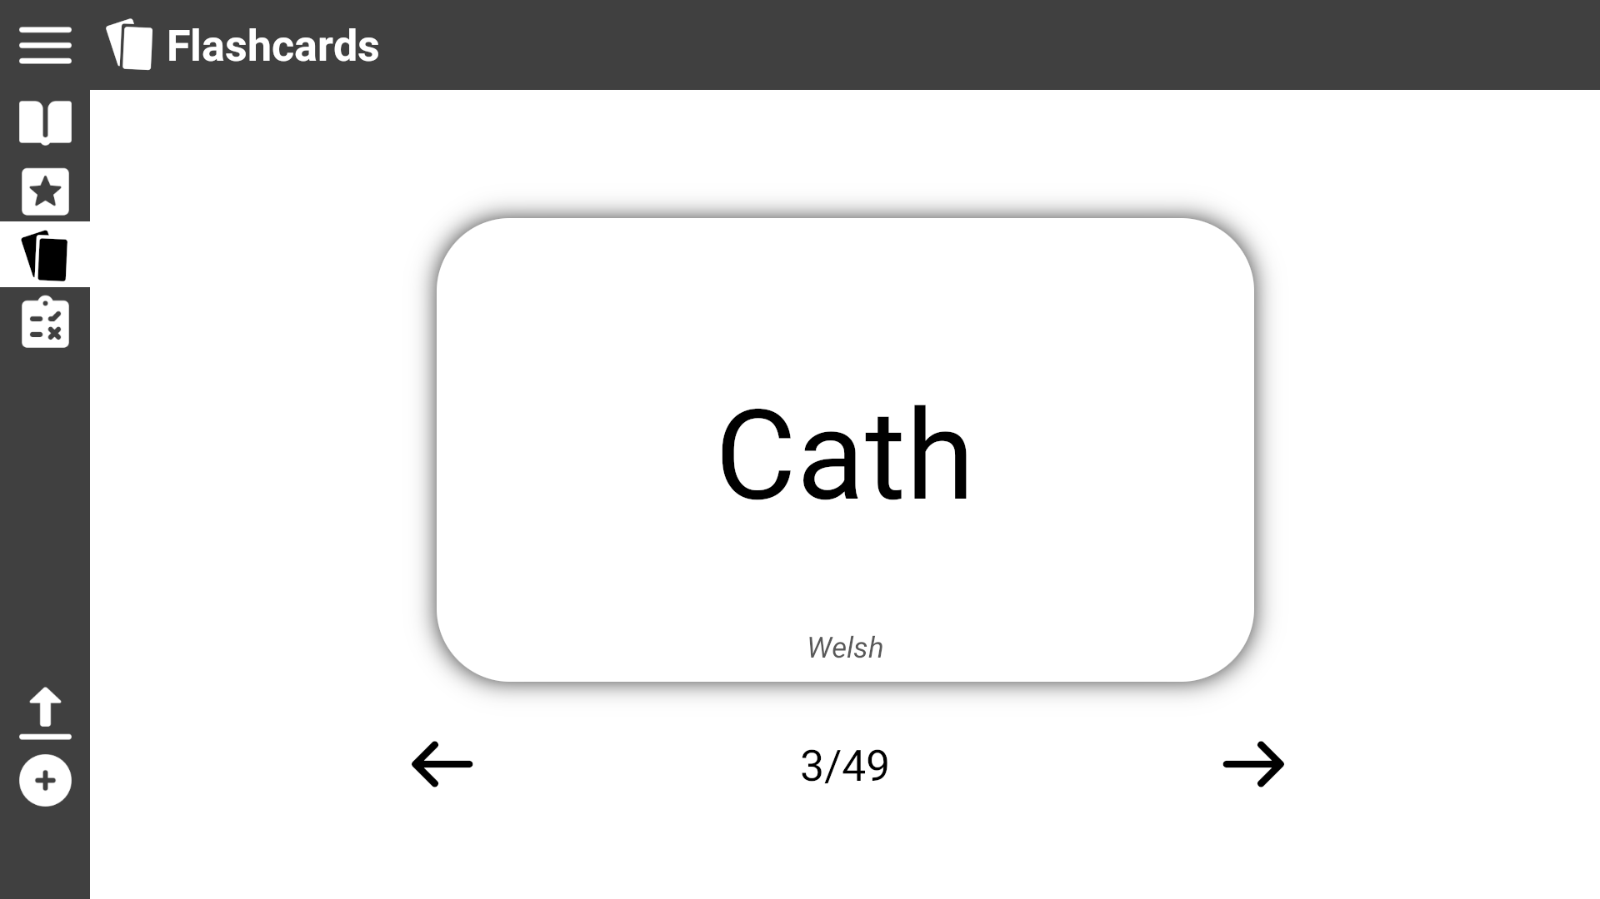
Use Case 6: View Flashcards
The user is presented a flashcard with one of their practise words
The user can click the card to flip it and see the translation
Language is shown at the bottom

Slide 26

Use Case 6: View Flashcards
The user can click the arrows to move to the next or previous card

Slide 27
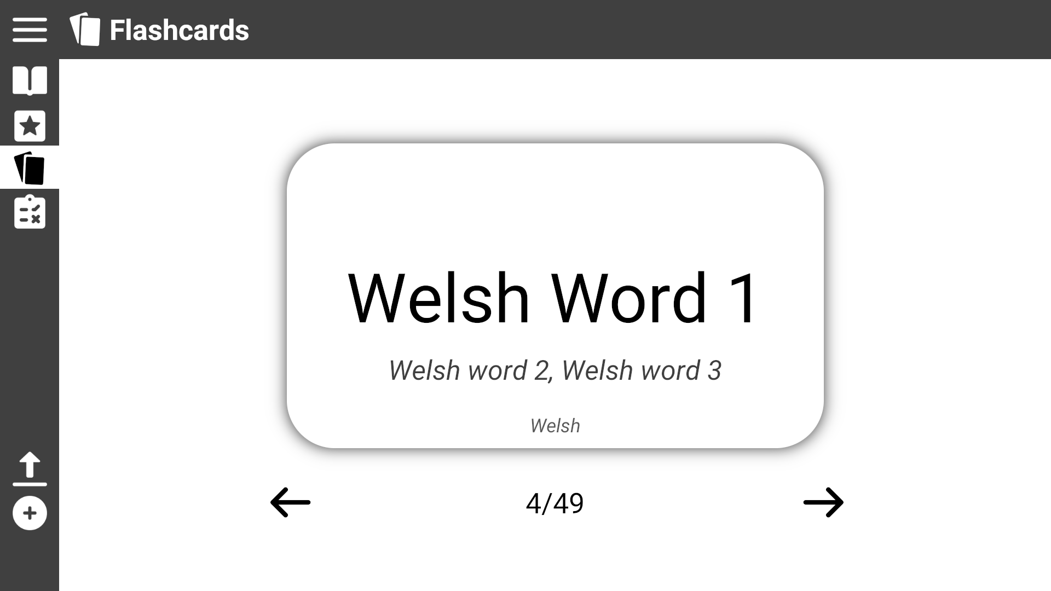
Use Case 6: View Flashcards
If the word on the other side can be translated in different ways the other translations are shown here
The user can click the card to flip it and see the translation

Slide 28
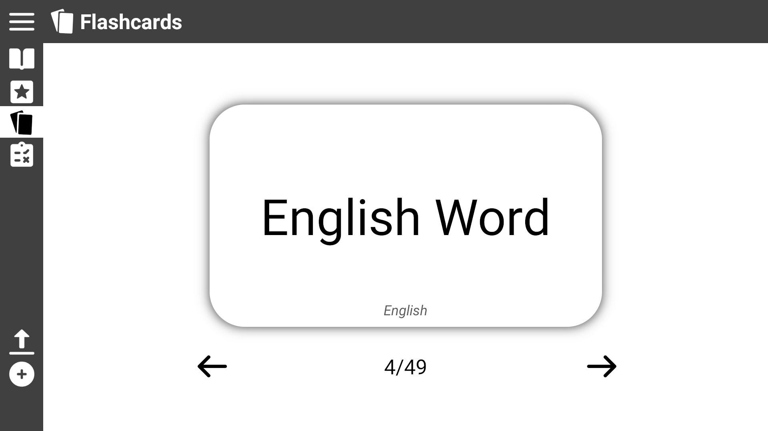
Use Case 6: View Flashcards

Slide 29
Use Case 7: Add a new word
Click the ‘Add’ icon

Slide 30

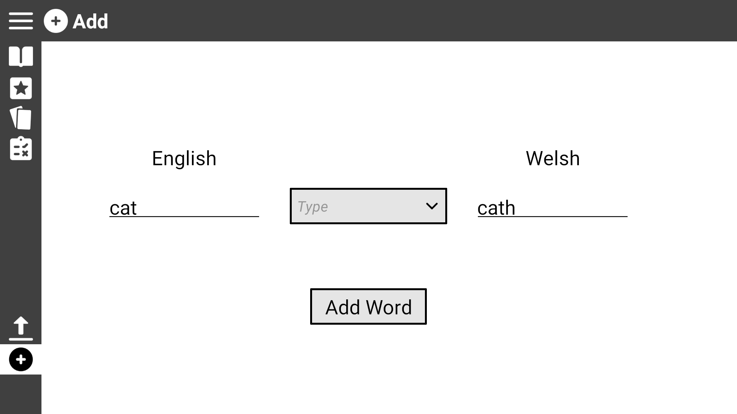

Use Case 7: Add a new word
Click on the drop down box to view the word types

Slide 31
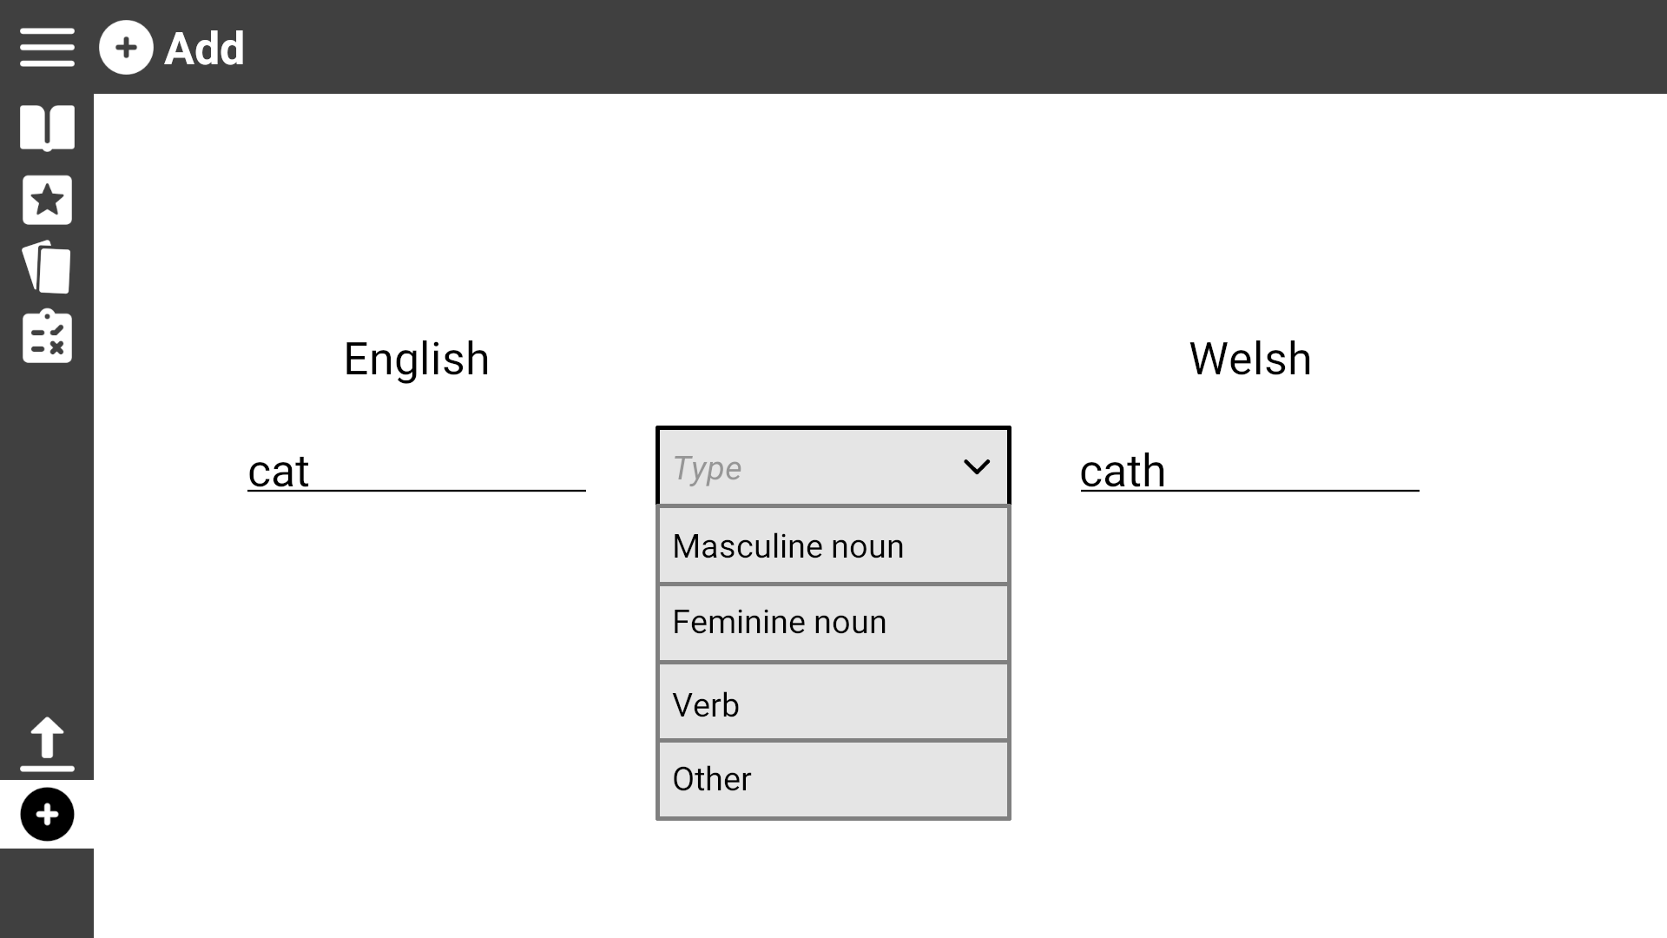
Use Case 7: Add a new word
Click on the drop down box to view the word types

Slide 32
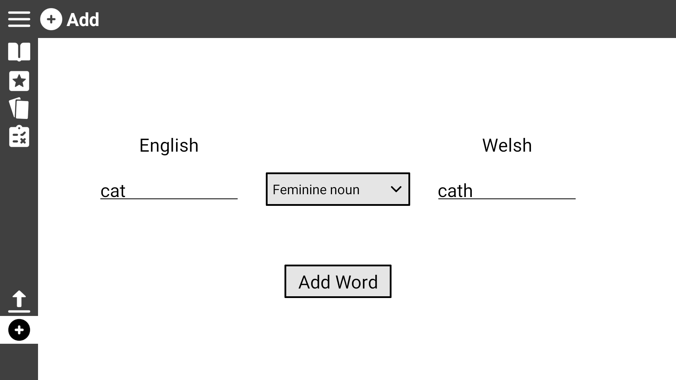
Use Case 7: Add a new word
Once every field is filled, click ‘Add Word’ to add it to the dictionary, it is also automatically added to the practise list

Slide 33
Use Case 8: Change word ordering
If not already, navigate to the ‘Practise List’ or the ‘Dictionary Page’ by clicking on their respective icons

Slide 34
Use Case 8: Change word ordering
Click on the ‘Change Language Order’ icon

Slide 35
Use Case 8: Change word ordering
Click on the ‘Change Language Order’ icon to revert back

Slide 36
Use Case 8: Change word ordering
Click on the ‘Change A/Z Order’ icon to change to alphabetically ascending or descending

Slide 37
Use Case 8: Change word ordering

